Slide 1
British Airways
Predicting Flight Booking

Slide 2
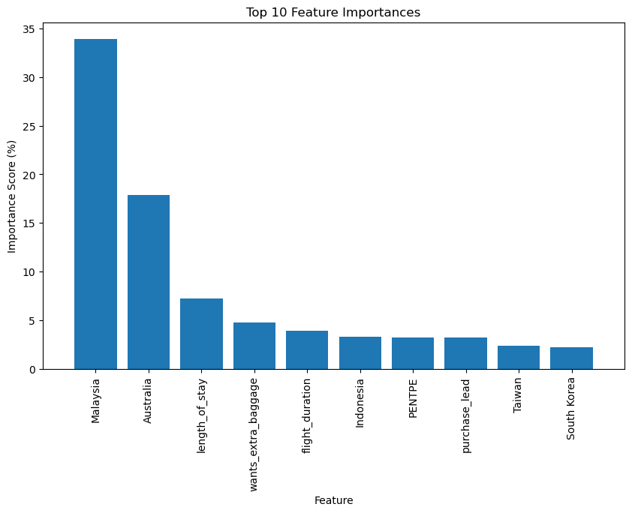
Top 10 Features for Predicting Flight Booking Using Gradient Boost Classifier.
Feature Importance Insights:
Malaysia(Origin)
Australia(Origin)
Length of Stay
Wants Extra Baggage
Flight Duration
Indonesia(Origin)
PENTPE(Route)
Purchase Lead
Taiwan & South Korea(Origin)
Model Performance:
Test Accuracy : 85.0%
AUC: Achieved 0.764, robust in predicting completions.
Recommendations:
Targeted Marketing: Focus on Malaysia, Australia, Indonesia, Taiwan, and South Korea.
Service Enhancements: Improve baggage and flight duration options.
Booking Lead Time: Optimize strategies for higher conversion rates.

